Slide 1
GDSC Solution Challenge IMPACT MINDS

Slide 2
INTRODUCTION
Our PowerPoint presentation on SDG 2: Zero Hunger passionately addresses the global imperative to eradicate hunger. The heart of our presentation lies in proposing innovative solutions, showcasing successful interventions, and emphasizing the crucial role of diverse stakeholders in achieving Zero Hunger. By highlighting best practices, advocating for policy changes, and fostering collaborative efforts, our presentation aims to contribute to the shared commitment of building a world where no one suffers from hunger. Through a framework for monitoring and evaluation, we emphasize the importance of data-driven decision-making to track progress effectively. Our goal is to inspire action and underscore the interconnectedness of global efforts towards sustainable and equitable development.

Slide 3
HOME PAGE
Our journey begins on the Home Page, a welcoming space that sets the tone for what's to come. It's all about simplicity and ease of navigation, ensuring everyone feels right at home.

Slide 4
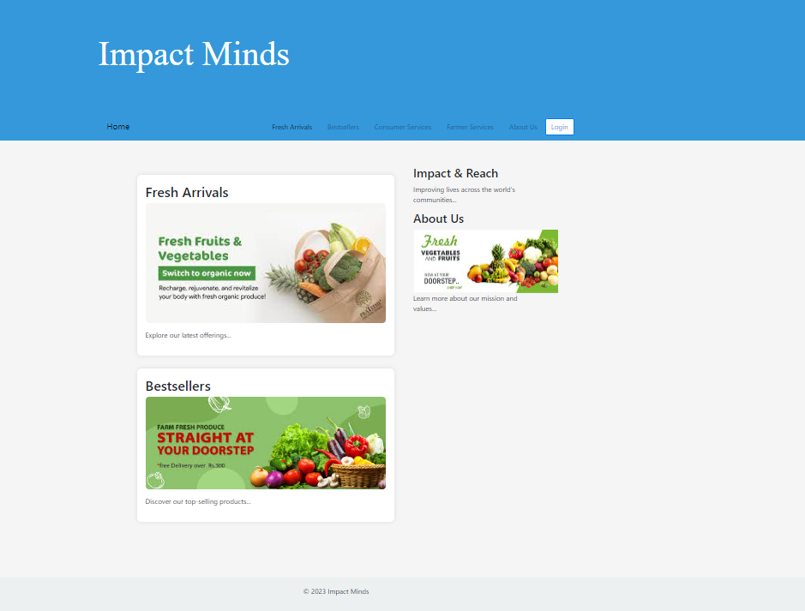

Slide 5
CONSUMER PAGE
Now, immerse yourself in the Consumer Page—a haven for veggie enthusiasts! Explore a diverse array of fresh produce while navigating through a seamless Payment Gateway. It's not just about transactions; it's an experience crafted for the joy of the process.

Slide 6
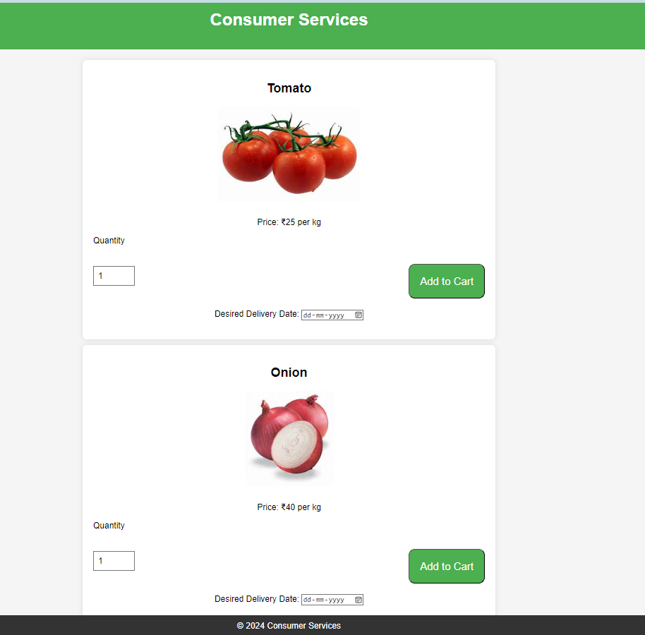

Slide 7
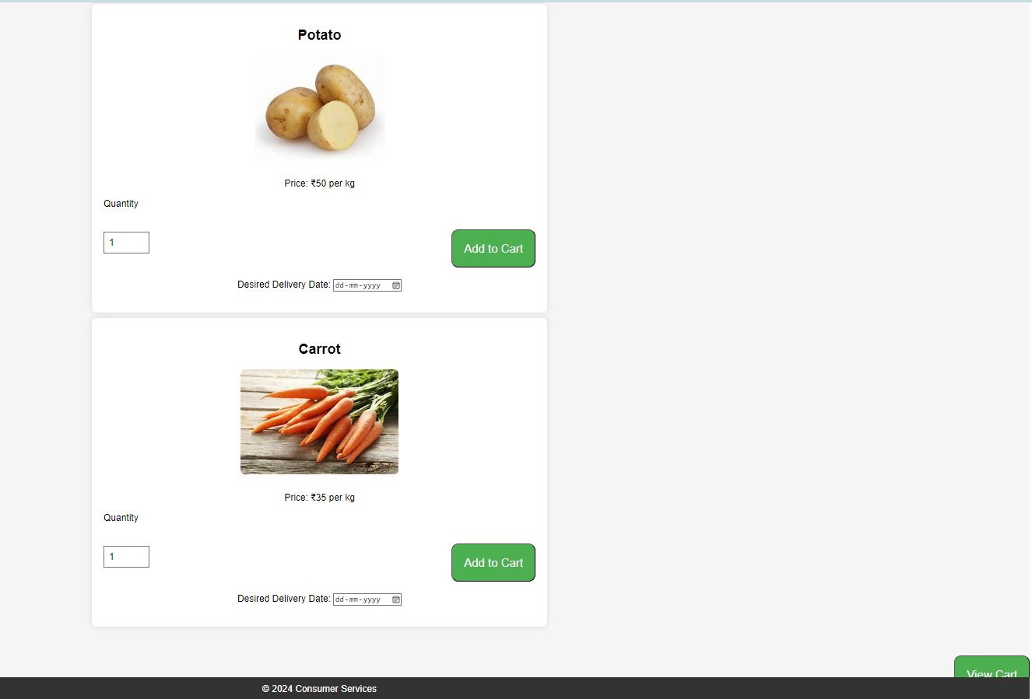

Slide 8
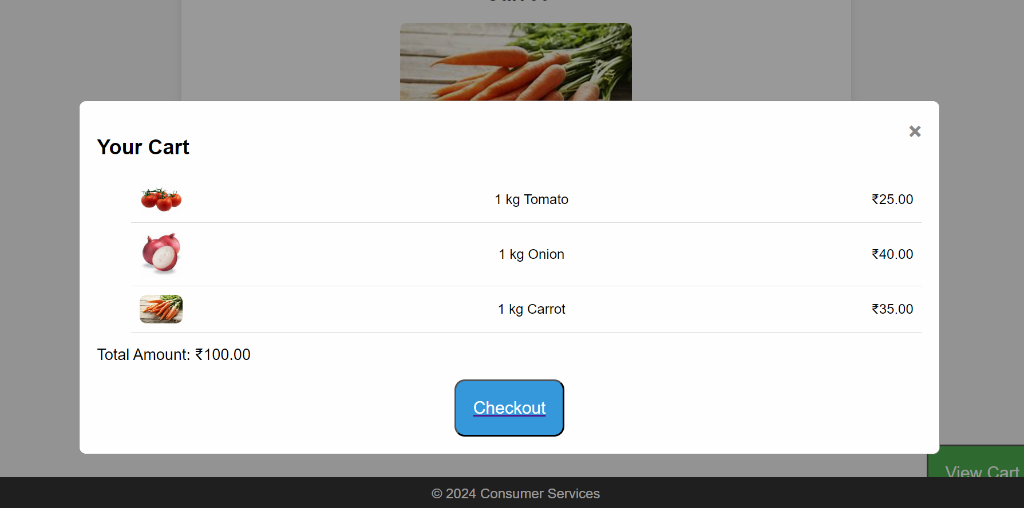

Slide 9
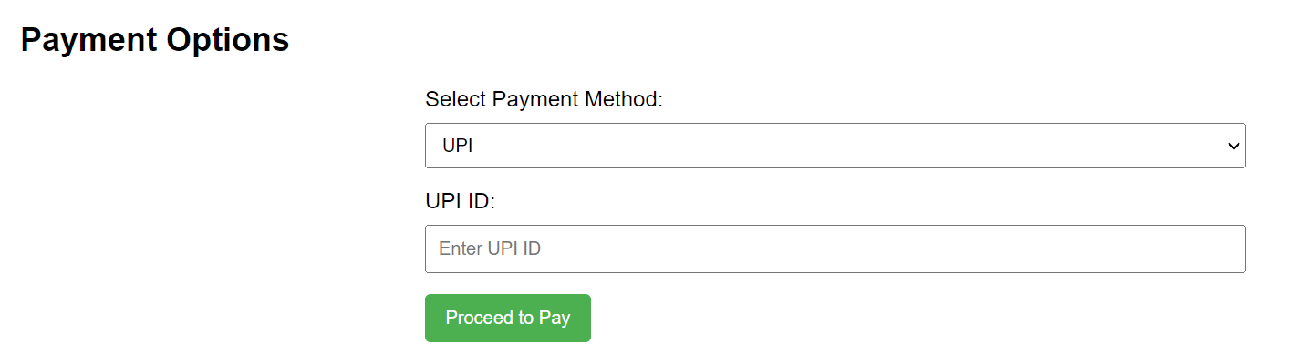
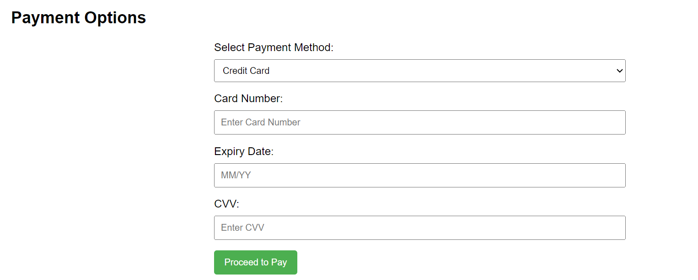
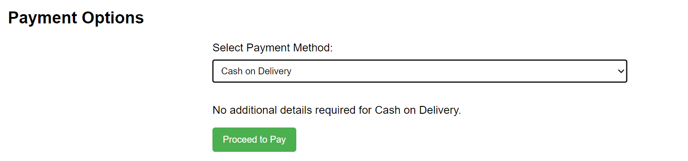
PAYMENT PAGE

Slide 10
FARMER SERVICES
Turn your attention to the Farmer Page, dedicated to our agricultural heroes. Powered by Google's geospatial magic, we empower farmers with valuable insights to elevate their farming practices. It's not merely information; it's a tool to assist them in selling their produce at the best prices.

Slide 11
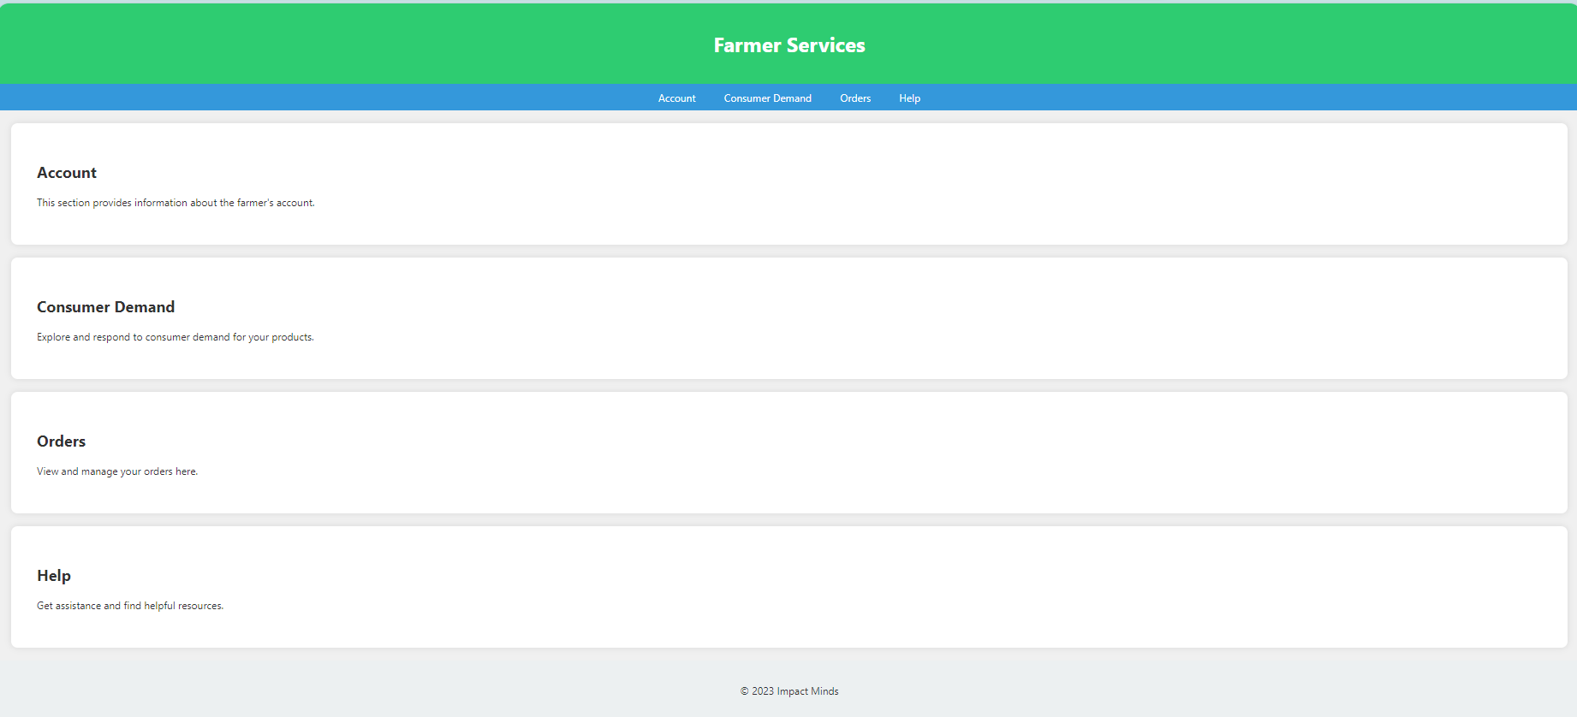

Slide 12
ABOUT US
Let's get personal on the 'About Us' page. Uncover who we are, our values, and why this journey transcends the concept of a mere website. It's a mission—a bridge that connects consumers and farmers, fostering a sense of community.

Slide 13
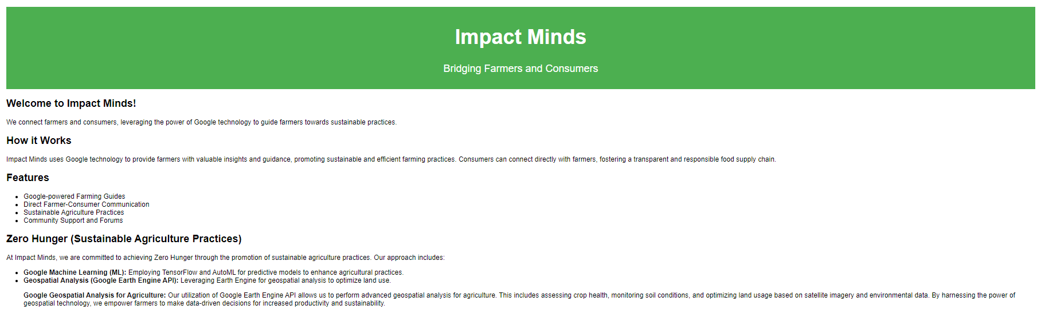

Slide 14
INTEGRATION WITH GOOGLE TECHNOLOGY
Delve into the tech realm as we join forces with Google, leveraging geospatial analysis. Picture farmers gaining the power of location-based insights, from understanding soil health to navigating climate conditions—a true tech-meets-agriculture magic show!

Slide 15
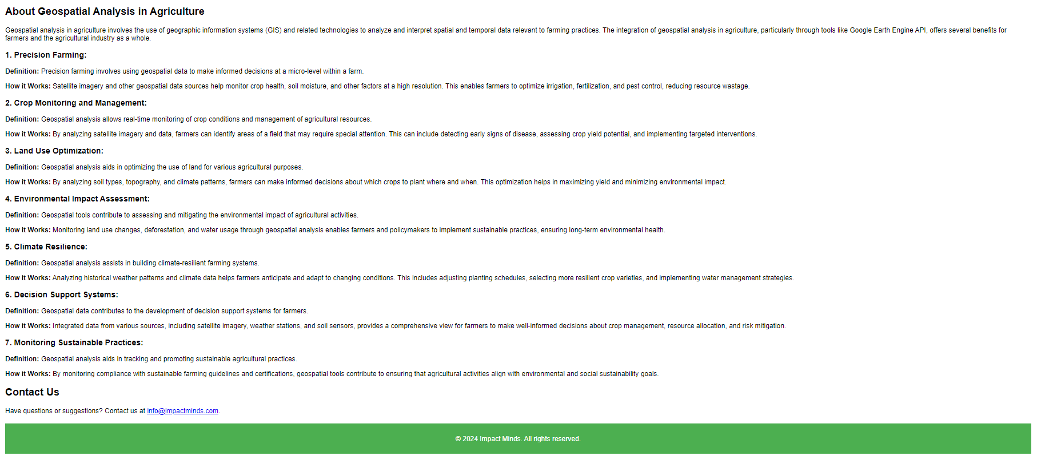

Slide 16
CONCLUSION
To wrap it up, our website isn't just a marketplace; it's a community-driven platform. By seamlessly connecting consumers with farmers, we're adding a tech-savvy twist to the agricultural landscape. Explore our website, and let's collectively contribute to this transformative agricultural revolution.

